Slide 1
Fixed networking performance issues
New Horde list panel and horde info panel
Designed rat variation components
More report work
Started video
More GPU optimisations
Reduce frequency of rat updates as performance gets worse
Distribute bots among joined clients to spread out load
Added movement indicator
Designed ability icons
Limit testing (500k rats at 60fps)
SCALE TEST 2!
Rewrite combat

Slide 2
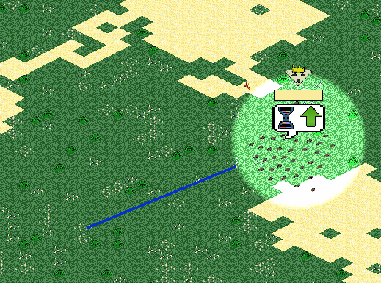
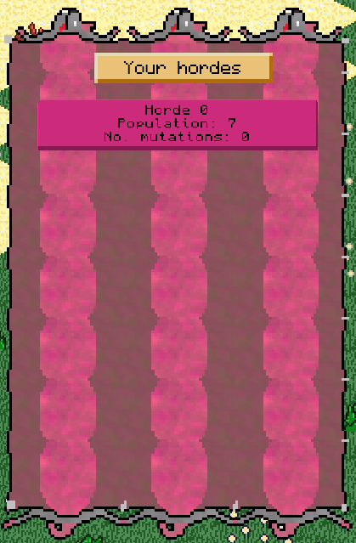

Slide 3
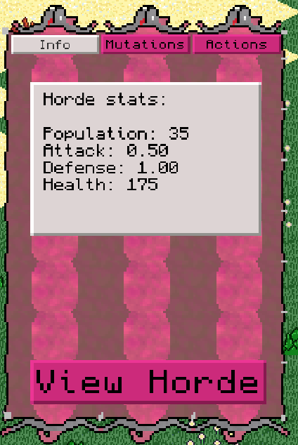
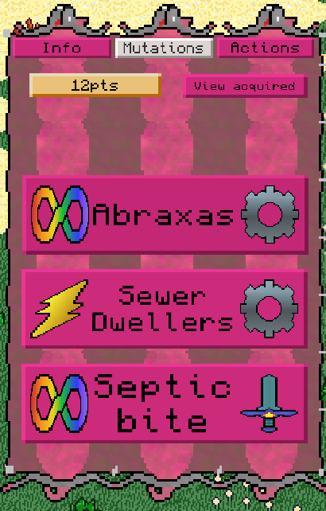

Slide 4
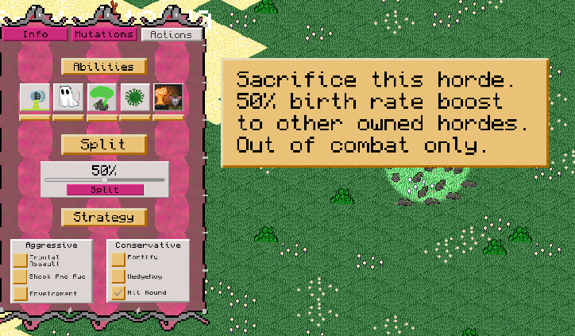

Slide 5
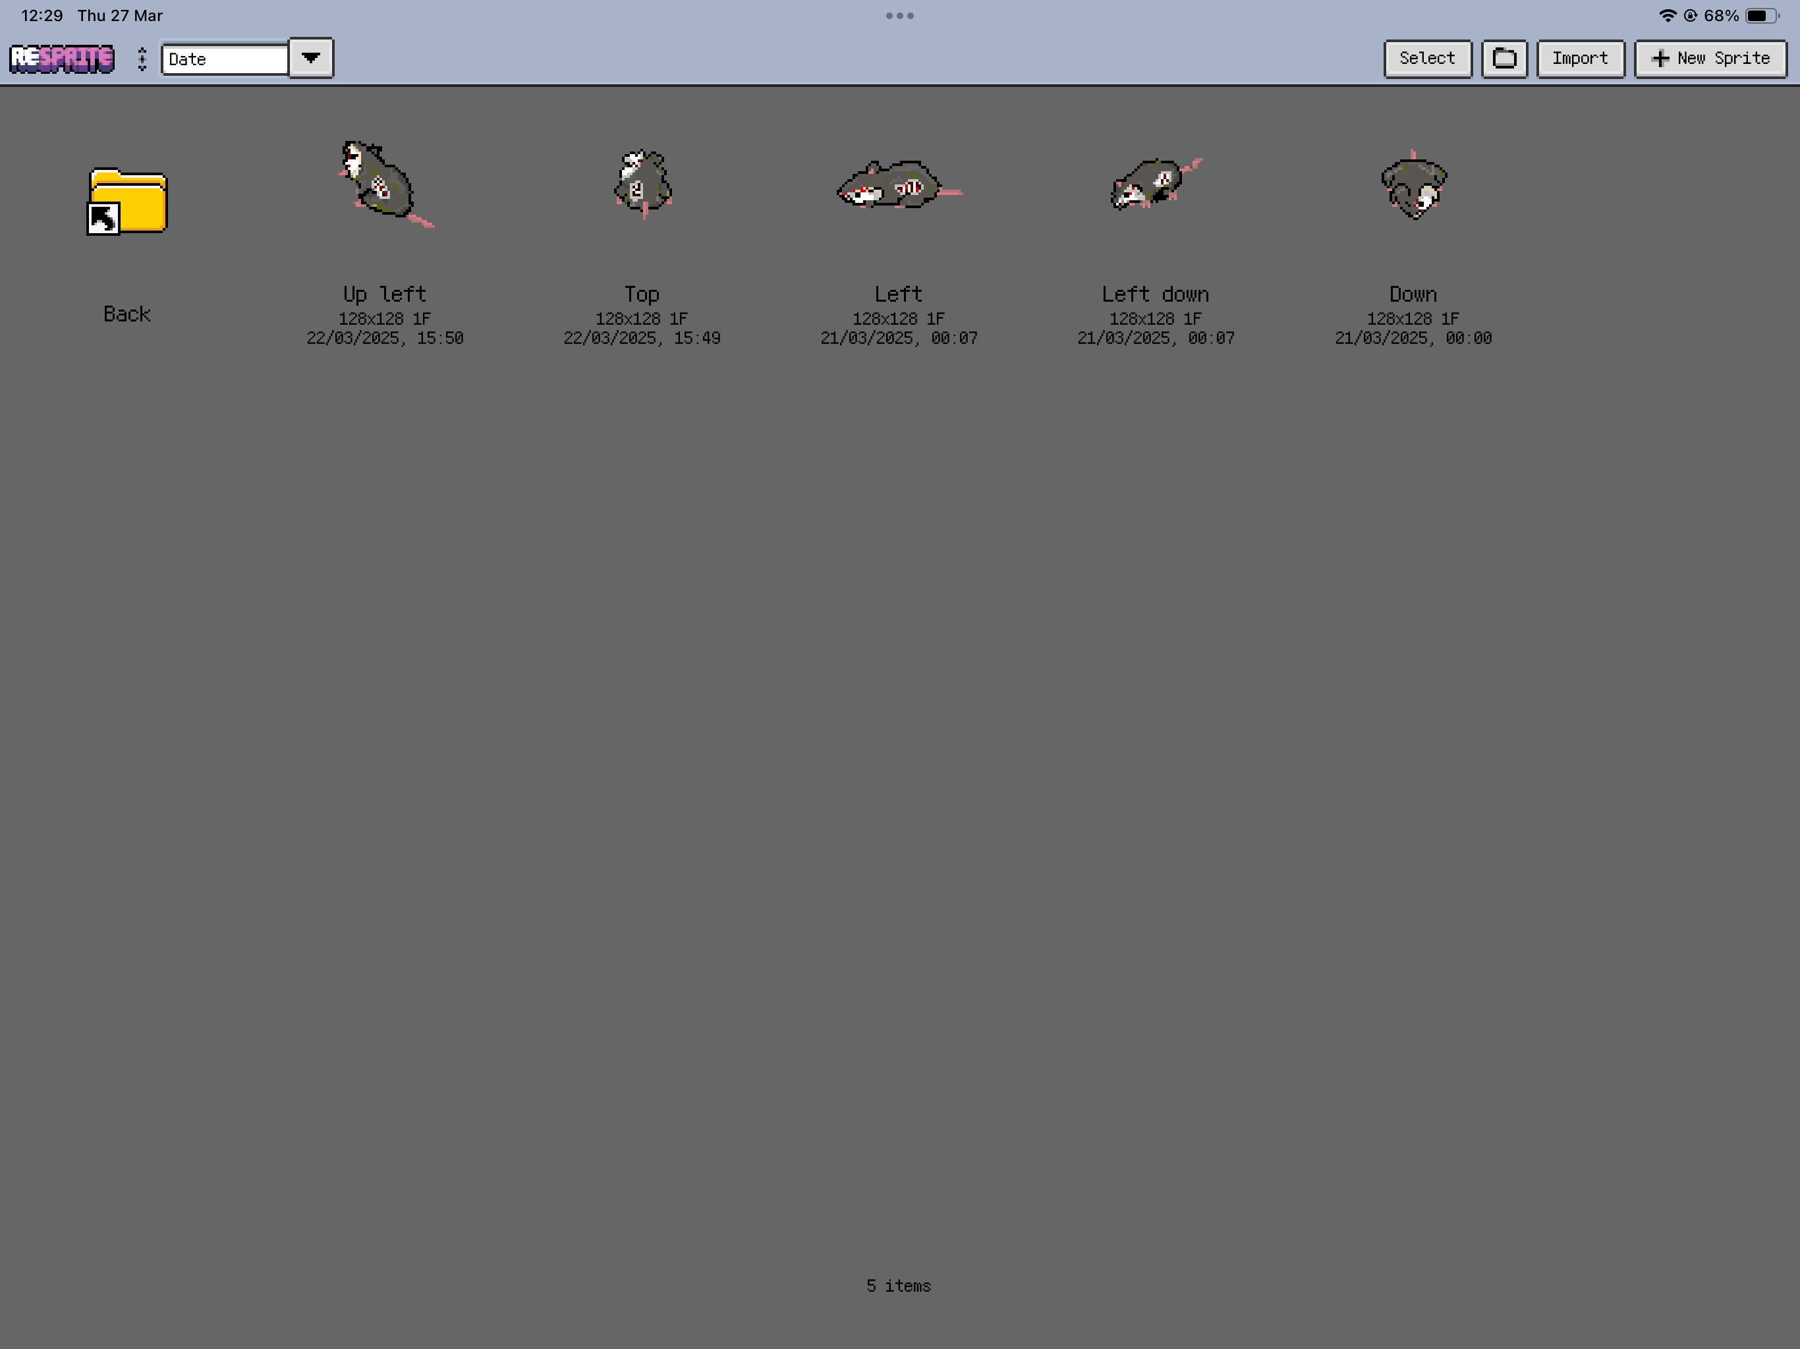
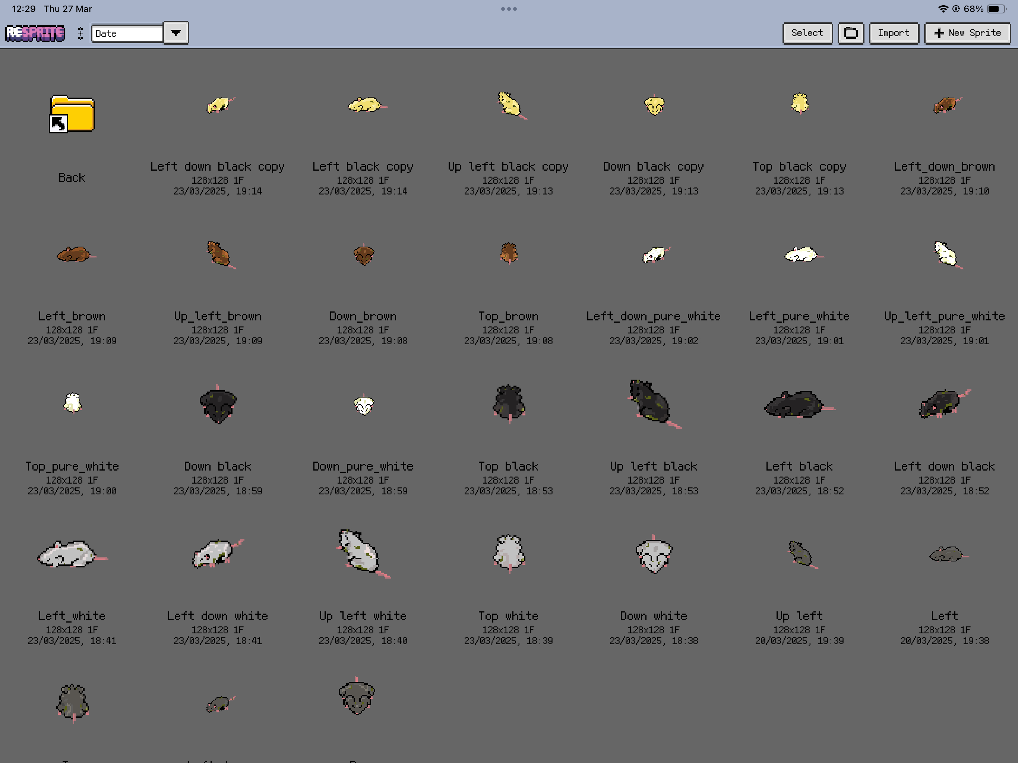

Slide 6
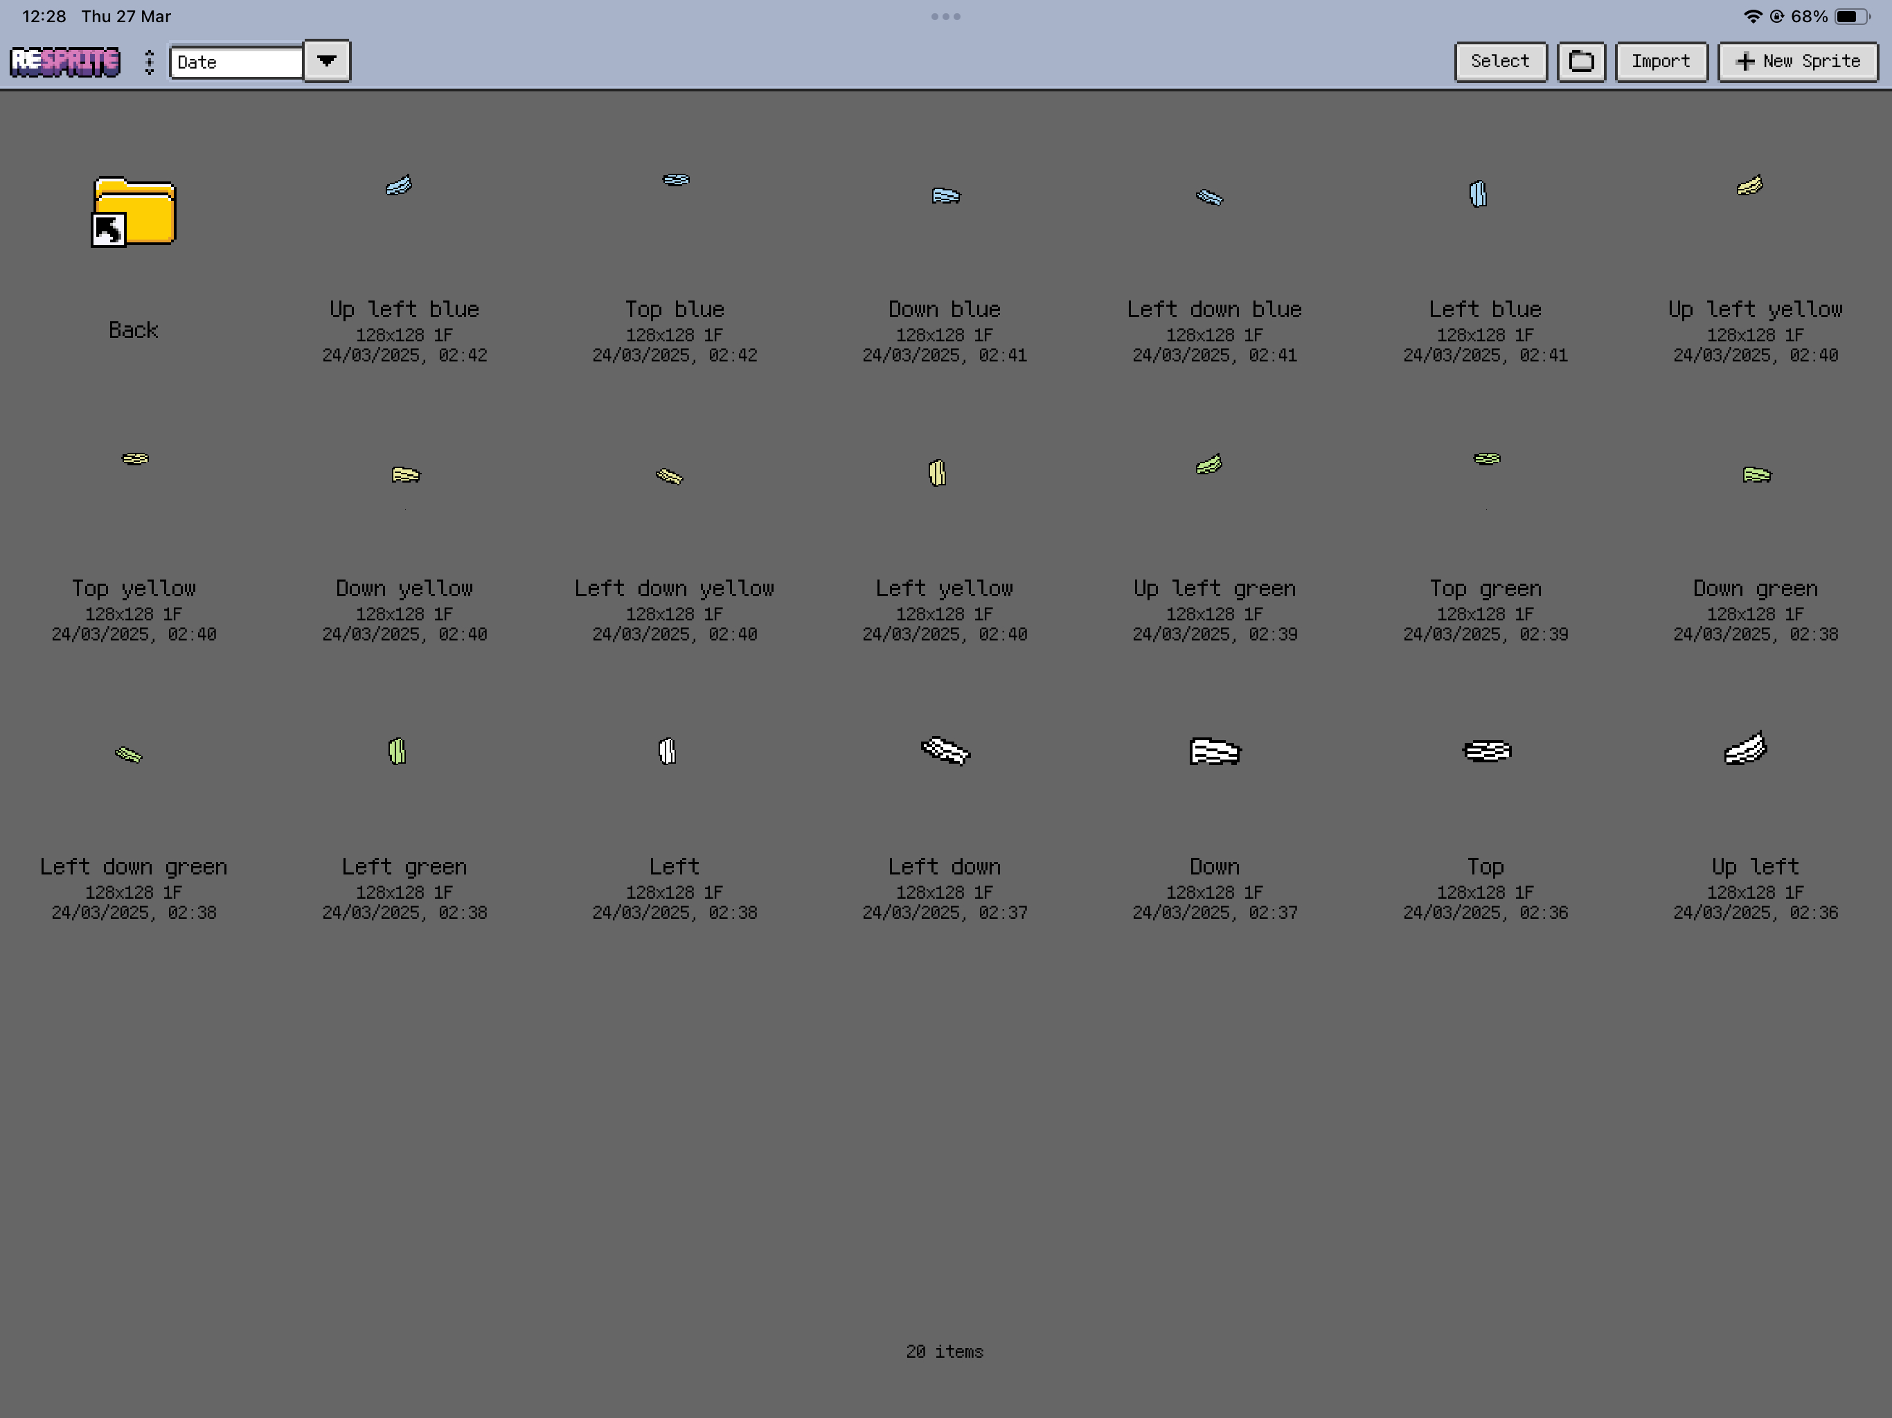

Slide 7
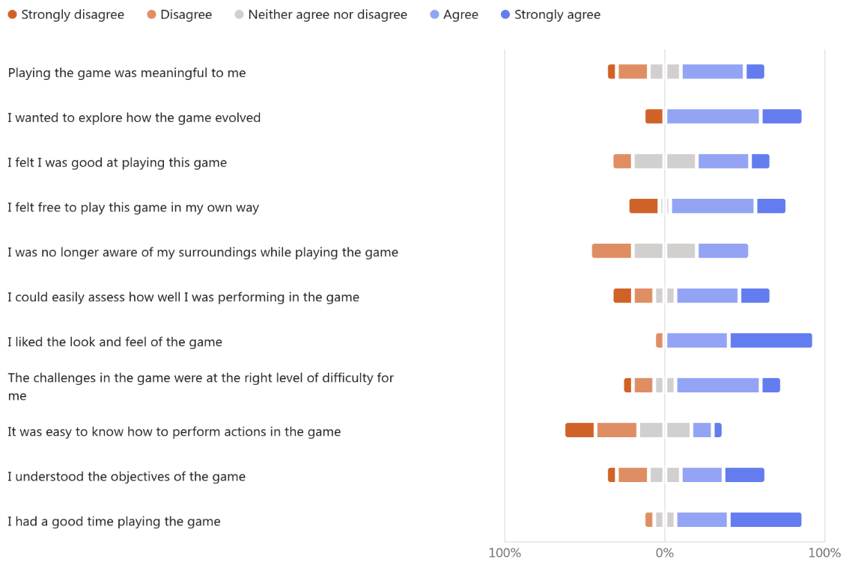
Scale Test 1

Slide 8
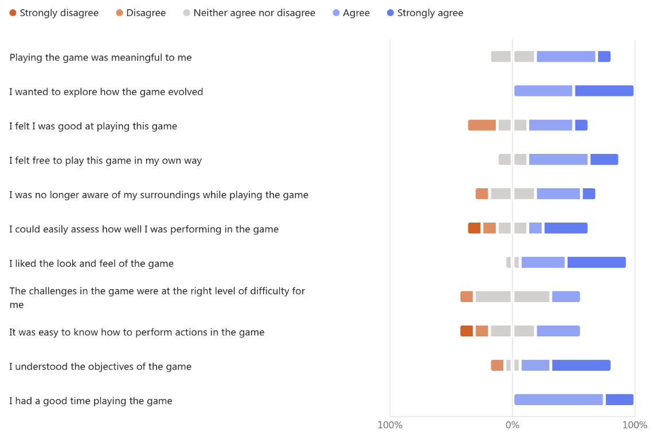
Scale Test 2

Slide 9
